Slide 1

Parking Team
Sensor Data Fusion
July 4, 19

Slide 2
Content
Introduction to Sensor Data Fusion
Data Fusion Architecture
Sensor Fusion Functions
Relation to our Project

Slide 3
Introduction to Sensor Data Fusion
Definitions:
Sensor fusion is combining of sensory data or data derived from sensor sources such that the resulting information has less uncertainty.
Precise Estimation
Data Fusion Component
Noisy
Data
Measurement
Data
Sensor
Sensor
Sensor

Slide 4
Introduction to Sensor Data Fusion
Advantages:
_{• Improves accuracy}
_{• Improves precision}
_{• Improves availability}
_{• Reduces uncertainty}
• Supports effective decision making
Challenges:
• There is no guarantee for the raw data quality
• The fused answer may be worse than the sensor
• There are no magic algorithms
• There will never be enough training data
• It is difficult to quantify the value of data fusion

Slide 5
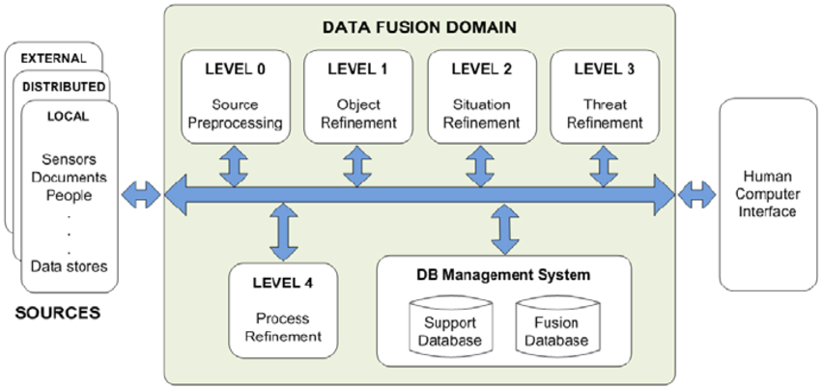
Data Fusion Architecture

Slide 6
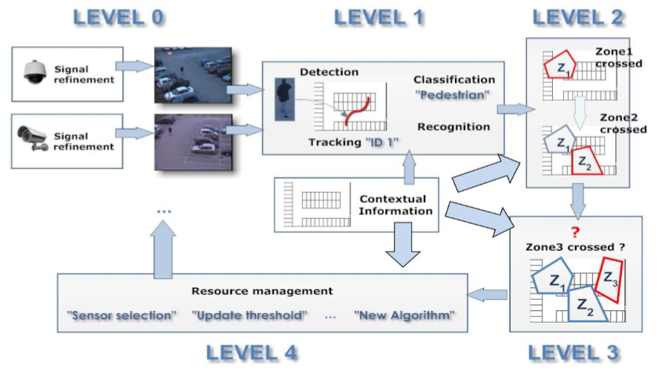
Data Fusion Architecture
• Level 0—Sub-Object Data Association and Estimation
• Level 1—Object Refinement
• Level 2—Situation Refinement
• Level 3—Significance Estimation
• Level 4—Process Refinement

Slide 7
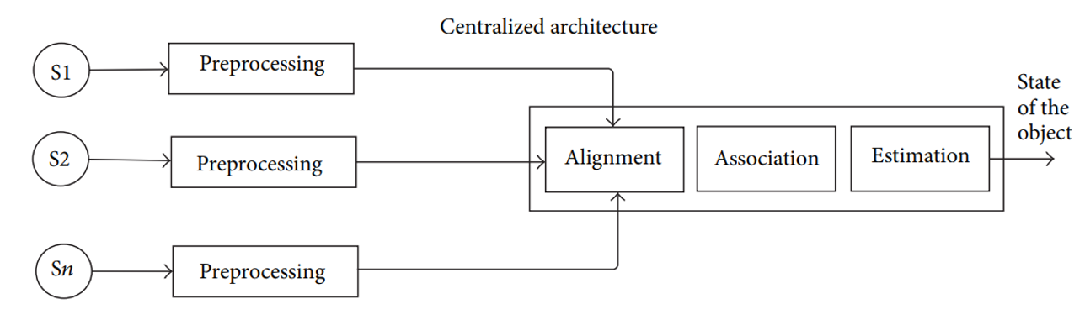
Data Fusion Architecture

Slide 8
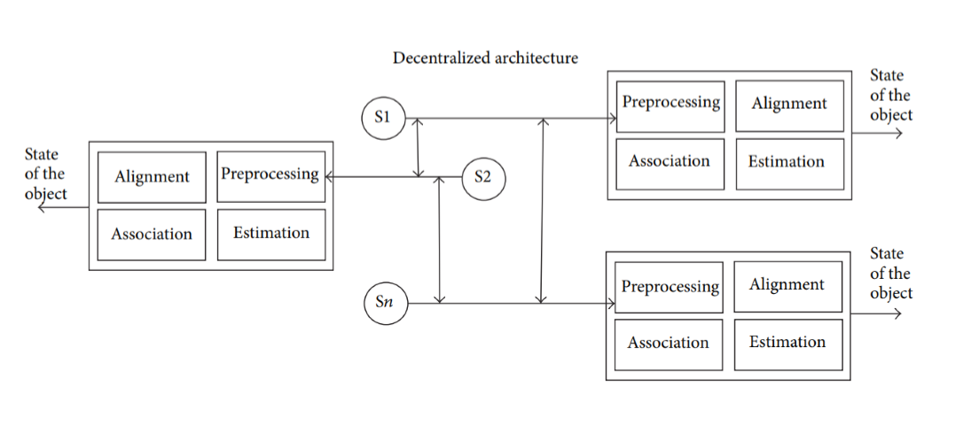
Data Fusion Architecture

Slide 9
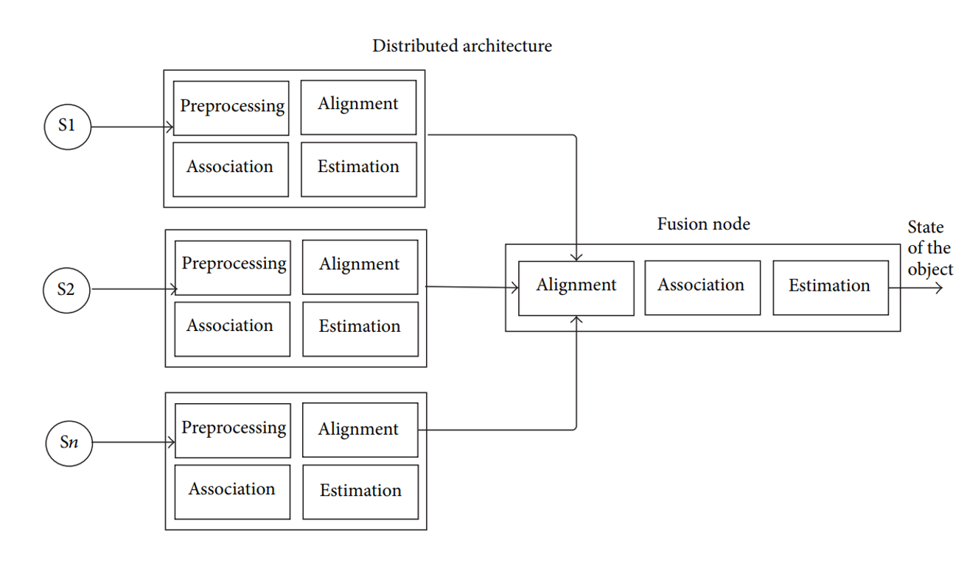
Data Fusion Architecture

Slide 10
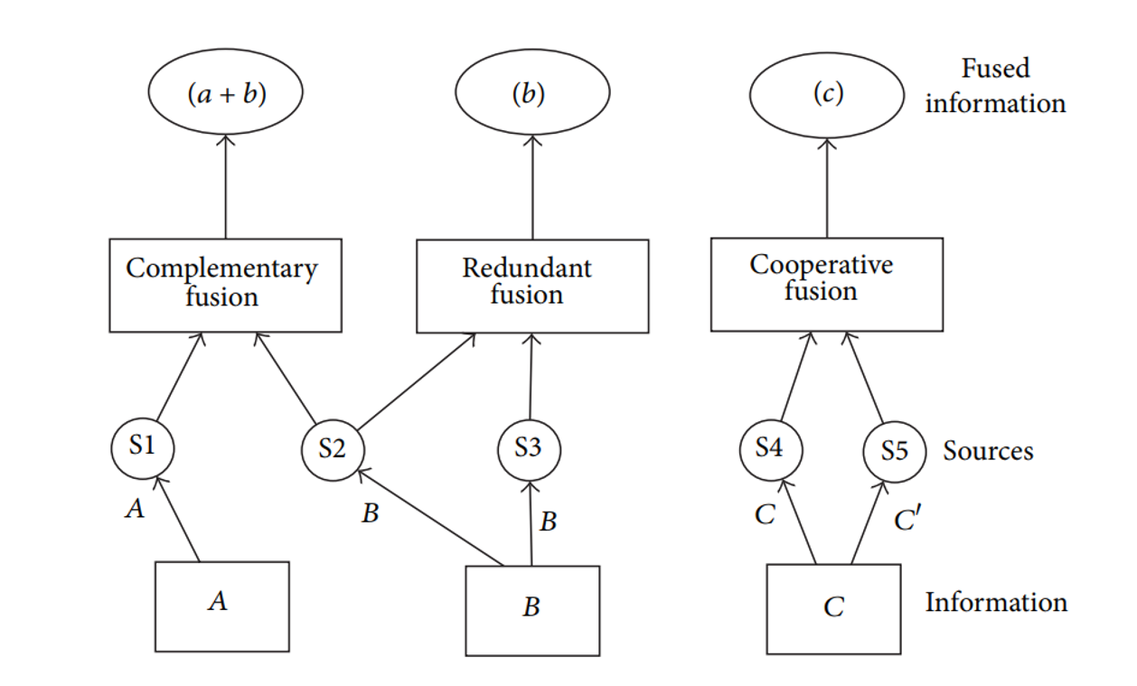
Data Fusion Architecture

Slide 11
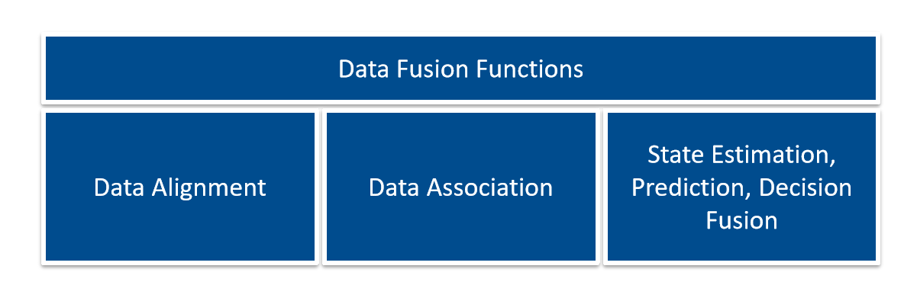
Sensor Fusion Functions
• By splitting Sensor Data Fusion into these subtasks, they can be studied individually
• Data Fusion functions include:
Data Alignment, Data Association, State estimation

Slide 12
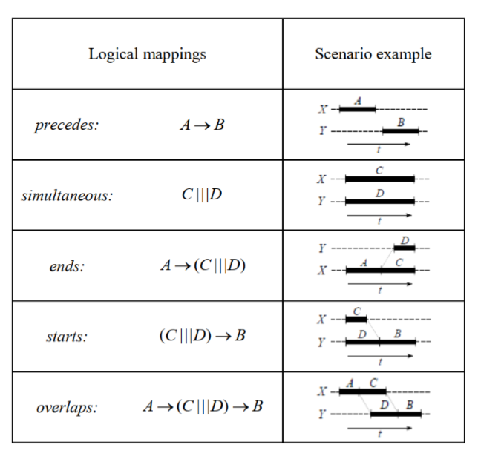
Sensor Fusion Functions
Data Alignment
• Detect temporal differences
• Adjust the collected data
• Synchronize using shared time.
• Synchronize via communication protocol.

Slide 13
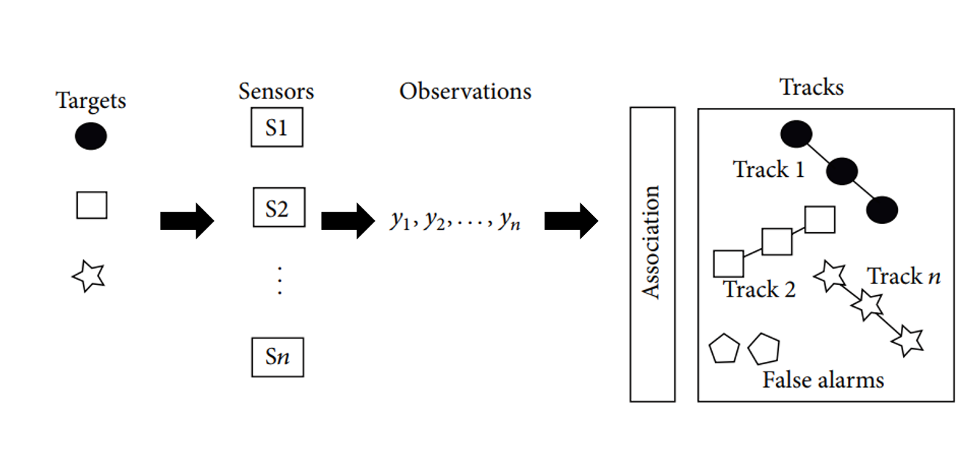
Sensor Fusion Functions
Data Association
Clustering: Nearest Neighbors and K-Means, Probabilistic Data Association

Slide 14
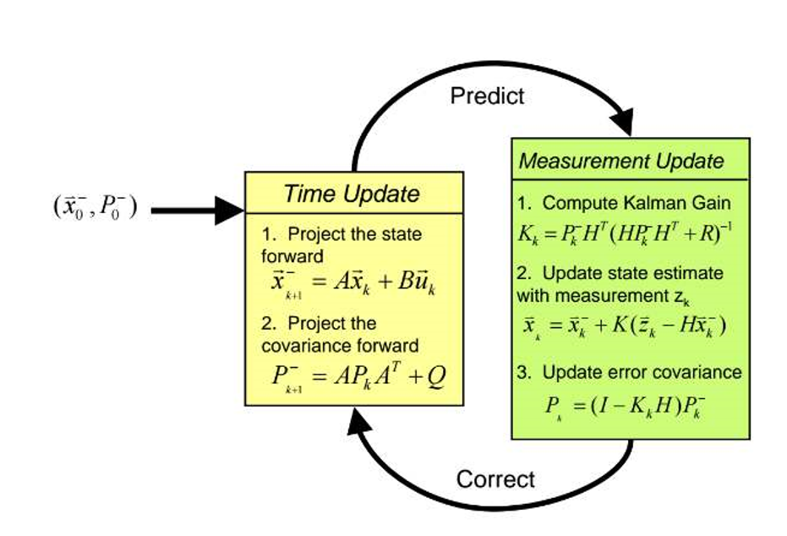
Sensor Fusion Functions
State Estimation Methods
Kalman Filter:

Slide 15
Sensor Fusion Functions
State Estimation Methods
A standard Kalman Filter can only handle linear models
• Non-linear process and sensor models：
Extended Kalman Filter (EKF) Unscented Kalman Filter (UKF)
• Extended Kalman Filter uses the Jacobian matrix to linearize non-linear functions
• Unscented Kalman Filter takes representative points from a Gaussian distribution

Slide 16
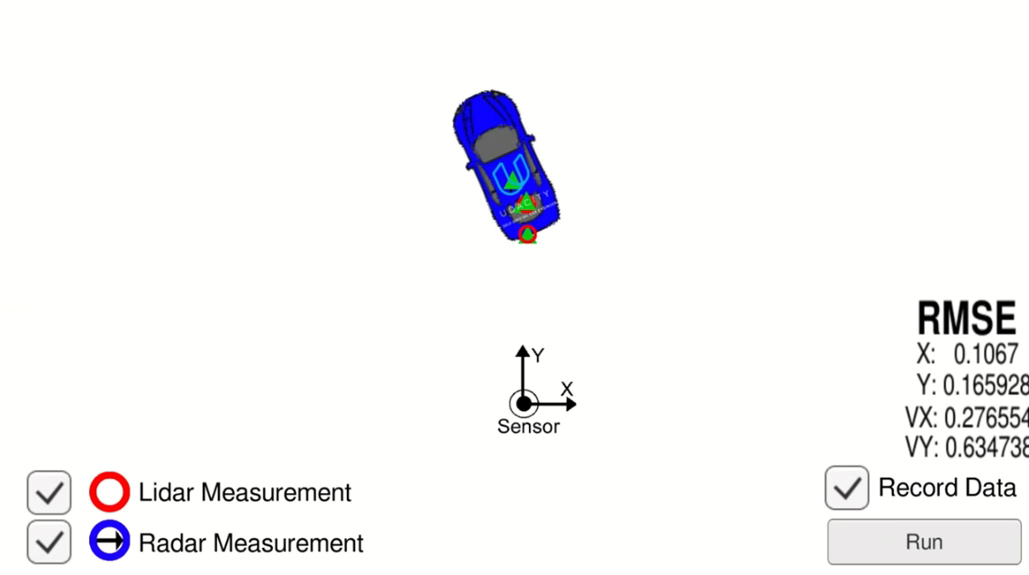
Sensor Fusion Functions

Slide 17
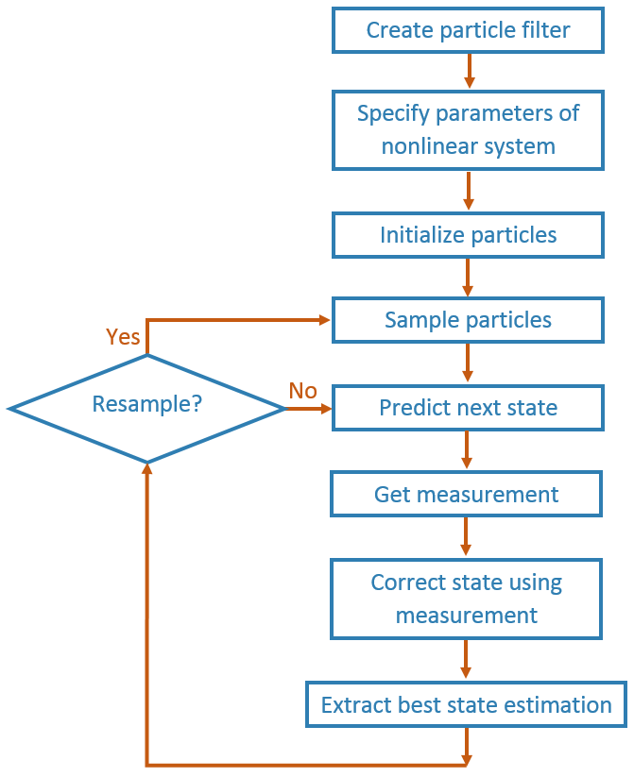
Sensor Fusion Functions
State Estimation Methods
Particle Filter:
Particle filters is a set of Monte Carlo algorithms used to solve filtering problems
• To handle non linear processes
• To handle non Gaussian Noise

Slide 18
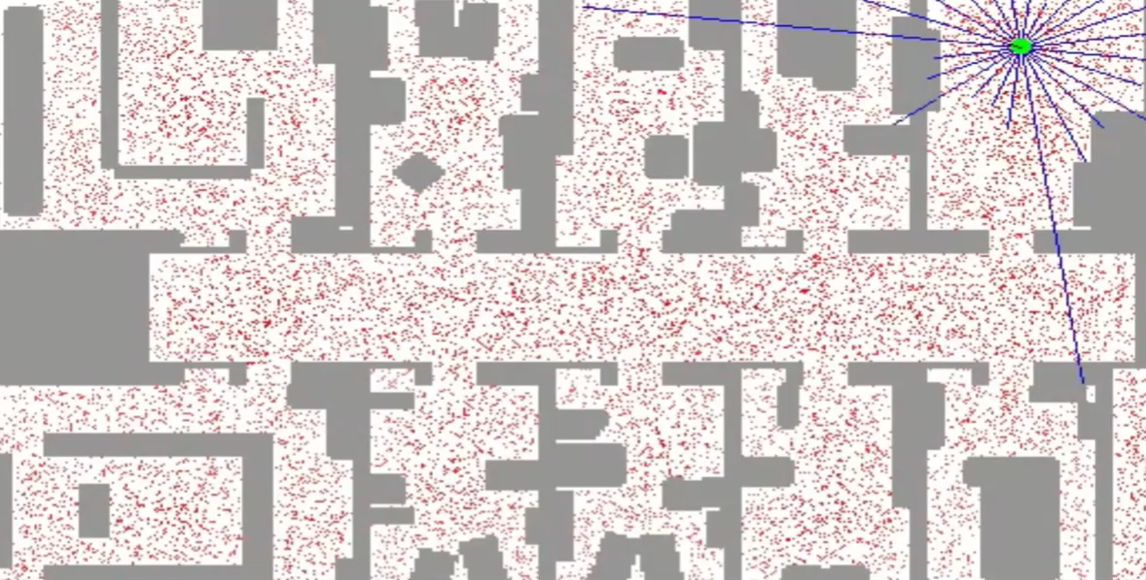
Sensor Fusion Functions

Slide 19
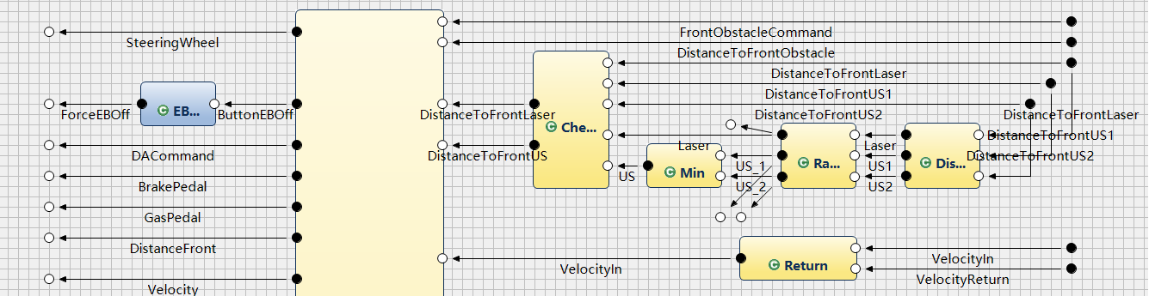
Relation to our Project
AF3 – Sensor Data Fusion

Slide 20
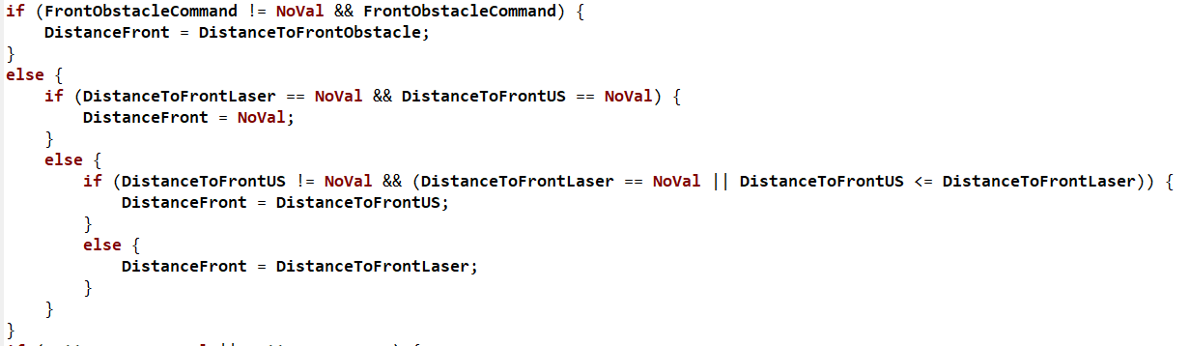
Relation to our Project
AF3 – Sensor Data Fusion

Slide 21
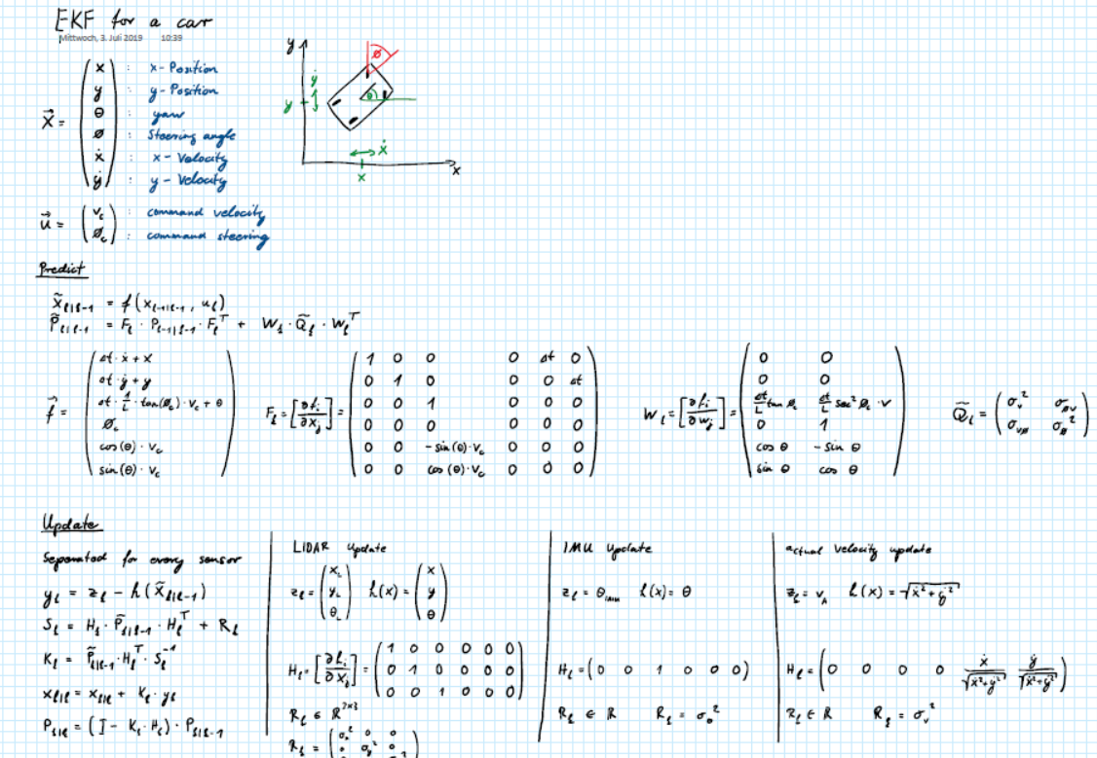
Relation to our Project

Slide 22
Resources
• Gereon Hinz, lecture Autonomous Fahren
• Darius Burschka. lecture Robot Motion Planning
• https://en.wikipedia.org/wiki/Extended_Kalman_filter
• https://www.youtube.com/watch?v=XswKMtQBTCo
• https://en.wikipedia.org/wiki/Expectation–maximization_algorithm
• https://en.wikipedia.org/wiki/Monte_Carlo_method

